Slide 1


2024/2025 Notice Of Funding Opportunity
Building Resilient Infrastructure and Communities (BRIC)
Notes:
Chelsea

Slide 2
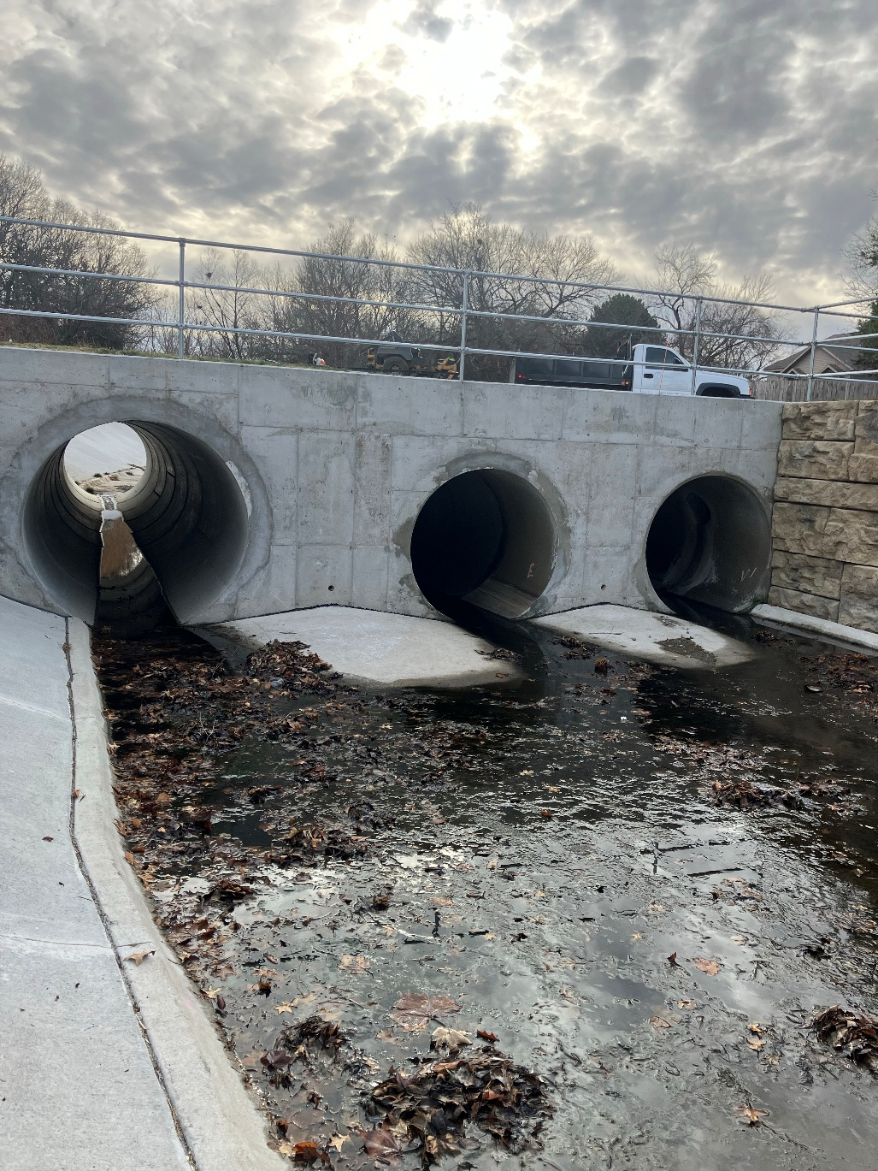
AGENDA
Funding overview
Program priorities
Eligible activities
Program requirements
Cost share requirements
State allocation
National competition
State and federal key dates
Job aids and resources
Questions
City of Lincoln, Forest Lake Blvd Drainage Improvement
Notes:
Chelsea

Slide 3
FUNDING OVERVIEW
State/Territory Allocation | Tribal Set-Aside
$2,000,000 | $50,000,000
The maximum allocation for a state or territory under this category is $2,000,000, covering all activities/projects, including management costs. | The combined cost for capability- and capacity-building activities under the Tribal Set-Aside must not exceed $2,000,000 federal cost share per applicant.
State/Territory Building Code Plus-Up | Tribal Building Code Plus-Up
$1,000,000 | $25,000,000
The maximum allocation for a state or territory under this category is $1,000,000, to carry out eligible building code adoption and enforcement activities | The maximum total selection for the Tribal Building Code Plus-Up is $25,000,000, to carry out eligible building code adoption and enforcement activities
National Competition
$20,000,000
Applicants may submit an unlimited number of hazard mitigation project subapplications, each valued up to $20,000,000 federal share, to the National Competition.
Notes:
Chelsea

Slide 4
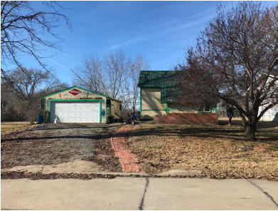
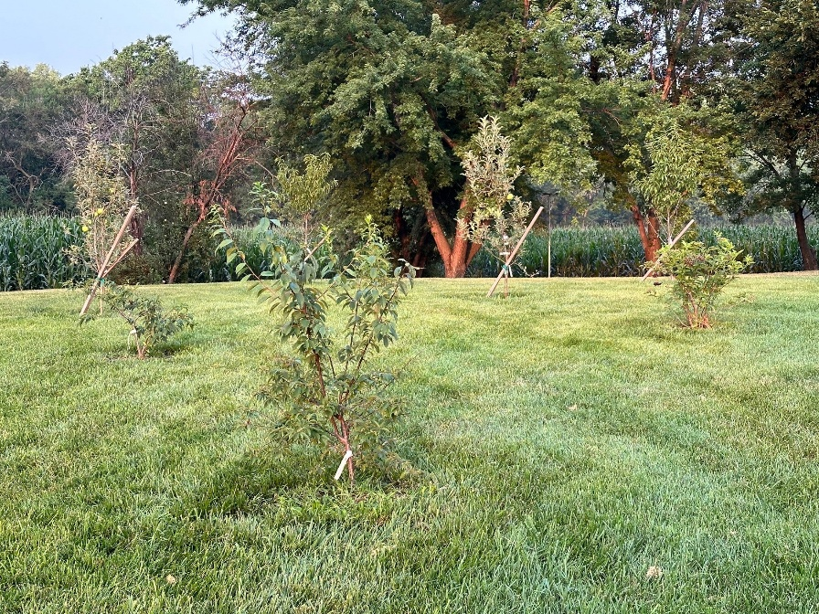
PROGRAM PRIORITIES
Capability and Capacity Building Activities
Directly supports infrastructure resilience
Public infrastructure
Adoption and enforcement of latest published hazard-resistant building codes
City of Hebron Acquisition 2022
City of Hebron Acquisition 2025
Notes:
Kevin

Slide 5
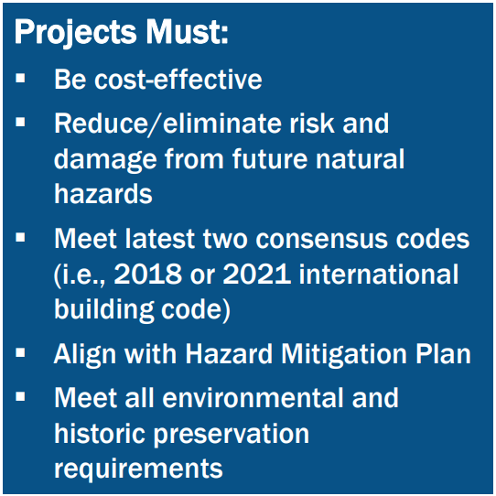
ELIGIBLE ACTIVITIES
Pre-award Costs
Capability- and Capacity-Building Activities – activities that directly support infrastructure resilience, such as the adoption, enforcement, and implementation of hazard-resistant building codes.
Hazard Mitigation Projects – cost-effective infrastructure and construction projects designed to increase resilience and public safety; reduce injuries and loss of life; and reduce damage and destruction to property, critical services, facilities, and infrastructure (including natural systems) from a multitude of natural hazards, including drought, wildfire, earthquakes, and the effects of natural weather disasters.
Notes:
Kevin
Pre-award costs – examples are costs incurred for application development, gathering required permits,
Capability- and Capacity-Building Activities – activities that directly support infrastructure resilience, such as the adoption, enforcement, and implementation of hazard-resistant building codes.
Hazard Mitigation Projects – Previous BRIC Scoping projects that are ready for construction, Safe rooms, Flood risk reduction, Acquisitions, Wildfire mitigation, Utility resiliency, infrastructure construction projects with a minimum of conceptual designs.
Projects not eligible under this NOFO – Hazard Mitigation Plan Updates, Scoping projects that do not focus on protecting critical infrastructure, phased projects, warning sirens

Slide 6
PROGRAM REQUIREMENTS
Potential subapplicants must have a FEMA-Approved Hazard Mitigation Plan by the application deadline, at the time of obligated funding and through the duration of the project.
Subapplicants applying for mitigation projects must provide a Benefit Cost Analysis or other documentation that validates cost-effectiveness.
Subapplicants must provide information & documentation needed to comply with the National Environmental Policy Act (NEPA)
Subapplicants must submit short bios and resumes. This should include the type of entity, organizational leadership, and board members along with both the names and addresses of the individuals. Resumes are subject to approval.
All other requirements are listed in the DHS NOFO
Notes:
Kevin
HMP – Understanding that some of these plans are going to expire at some point during the duration of this grant, (read first bullet)
BCA – if you need assistance completing a BCA please reach out to your NEMA contact. NOTE: Engineers need to sign off on professional estimates
Subapplicants/subrecipients must submit short bios and resumes. This should include the type of entity, organizational leadership, and board members along with both the names and addresses of the individuals. Resumes are subject to approval.

Slide 7
COST SHARE REQUIREMENTS
FEMA will reimburse up to 75% of the total project cost
Example: Project total = $1 million; FEMA= $750,000; Non-federal= $250,000
BRIC requires a 25% non-federal cost share
Include a local financial commitment letter
Identify sources of local match: cash, in-kind, homeowner contributions, other sources as applicable
Funds must be available for the duration of project implementation
Management costs (administrative expenses)
100% federal reimbursement of all eligible costs
Small Impoverished Communities may be eligible for 90% Federal Cost Share:
Community of 3,000 or fewer residents
Per capita income does not exceed 80% of the national average
Notes:
Alyssa

Slide 8
COST SHARE REQUIREMENTS - MANAGEMENT COSTS
BRIC allows subrecipients to request up to 5% of their grant award for management costs
Management costs are those costs necessary to administer and implement the federal award.
Provide a brief narrative to explain the budget line items
*NOTE: Management costs are paid out on project actuals – subrecipient cannot exceed more than 5% of the project actual costs.
Personnel & fringe benefits
Travel & Per Diem
Equipment
Supplies
Other indirect costs
Notes:
Alyssa

Slide 9
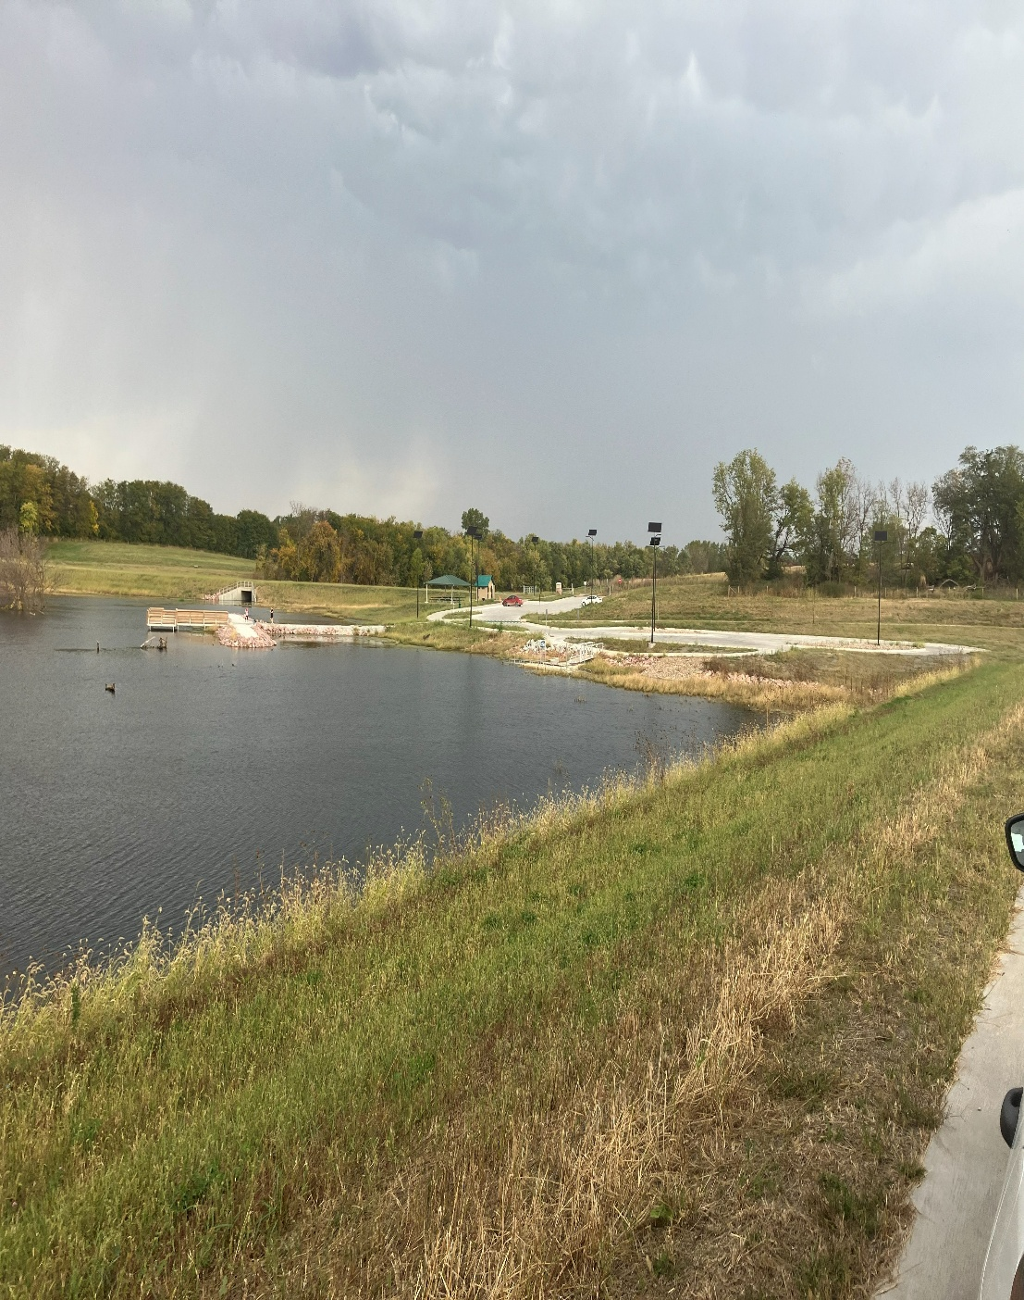
NATIONAL COMPETITION
$20 million (federal share) per subapplication
No limit on the number of project subapplications submitted per Applicant/State
Any project that exceeds the state allotment amount will automatically be submitted under National Competition
Papio-Missouri NRD WP4 Stormwater Management
Notes:
Alyssa
National Competition – these applications are competing nation wide for this funding. Applications must be extensive, detailed and complete to ensure the application is competitive in the eyes of reviews across the nation.

Slide 10
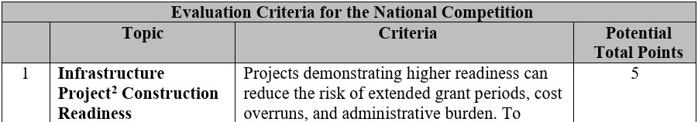
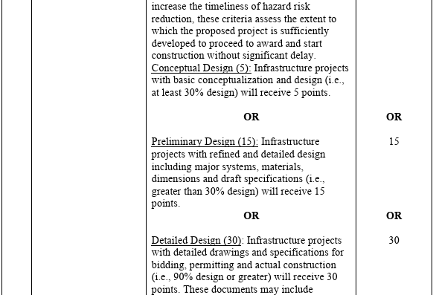
NATIONAL COMPETITION – TECHNICAL CRITERIA
Subapplicants should screen their potential projects for competitiveness based on the 2024 HMA Guidance and the BRIC NOFO.
All criteria must be addressed
Notes:
Angelina
Technical Criteria is based on a scale of up to100 total points. The application detail and completeness is scored on this criteria.

Slide 11


NATIONAL COMPETITION – GO/NO-GO MILESTONES
The subapplicant must identify at least one or more Go/No-Go milestones in the work schedule for mitigation activities that FEMA will review and approve
Does not apply to projects under the state allocation
Notes:
Angelina
Go No/Go milestones can be feasibility, construction, permitting check points. Missing these milestone deadlines can result in FEMA canceling the project.
Go No/Go milestones are not required for projects under the state allocation but are strongly recommended.

Slide 12
NEMA BRIC NOTICE OF INTEREST (NOI)
Interested eligible subapplicants must submit a completed NOI to the NEMA Hazard Mitigation Unit https://nema.nebraska.gov/hazard-mitigation-assistance-grants.php by May 1, 2026
If you need assistance completing the form or would like to discuss details of your potential project, please reach out to the NEMA HM Unit.
Notes:
Angelina

Slide 13
KEY DATES
Completed NOIs submitted to NEMA Hazard Mitigation Unit | May 1, 2026
State selection of projects to move forward with formal FEMA application | May 5, 2026
FEMA formal Application Start Date | March 25, 2026
State application submission deadline (complete applications submitted to NEMA Hazard Mitigation Unit for review) | July 15, 2026
Deadline to notify FEMA to any technical issues outside of their control that will prevent application submission | July 21, 2026 No later than 2:00 PM Central Time
FEMA Application Submission Deadline | July 23, 2026 @ 2:00 PM Central Time
Notes:
Erica
Communication during this time is crucial there is no room for extensions – if a deadline is missed your application will no longer be considered for this funding

Slide 14
HOW TO APPLY
NEMA must have a NOI on file to be considered for prioritization https://nema.nebraska.gov/hazard-mitigation-assistance-grants.php
NEMA will notify all potential sub-applicants if their NOI was selected to move forward with application development
Eligible Applicants must apply for funding using FEMA Grants Outcomes (FEMA GO) at the FEMA GO Portal.
Visit FEMA GO Guides and Resources to view the technical user manuals and support material
For FEMA GO Technical Support, contact the Help Desk by calling 1-877-611-4700 or by email at: femago@fema.dhs.gov
Applications must be developed in FEMA GO and submitted to NEMA by July 15, 2026
NEMA will submit all completed application materials in FEMA GO before
July 23, 2026
Notes:
Erica

Slide 15
Important Timelines
Application submission
Due to NEMA July 15, 2026
Due to FEMA July 23, 2026
FEMA Review
Review times vary by project complexity
Grant Period of Performance
36 Months from the initial grant award
Closeout
Subrecipients have 90 days to submit all final documentation once the project is reported as work completed.
Notes:
Erica
POP is 36 months from the award of the grant not each project.

Slide 16

FEMA PROGRAM RESOURCES
BRIC Support Materials:
NOFO
Hazard Mitigation Assistance (HMA) Materials:
HMA Guidance (2024)
Resources
Cost Share Information:
Cost Share Requirements
Additional Information:
Mitigation Action Portfolio
Nature-based solutions
Social Vulnerability:
FEMA National Risk Index
Notes:
Chelsea
More resources are available for application development, these are some program resources

Slide 17

Questions? Contact the NEMA Team
nema.hazardmitigation@nebraska.gov
Chelsea Harris
State Hazard Mitigation Officer
402.430.2252
chelsea.harris@Nebraska.gov
Erica Wertz
Recovery Program Specialist II
402.480.1419
erica.wertz@nebraska.gov
Alyssa Grosse
Recovery Program Specialist I
531.289.5546
alyssa.grosse@nebraska.gov
Kevin Cotter
Recovery Program Specialist I
531.893.0650
kevin,cotter@nebraska.gov
Angelina Allen
Recovery Program Specialist I
531.530.7809
angelina.allen@nebraska.gov
Notes:
Chelsea

